Slide 1
Python Data Structures: A revision
Asif Mahmud
ML Engineer, Polyfins Technology Inc.

Slide 2
Overview
Arrays
Lists
Tuples
Sets
Dictionaries

Slide 3
Arrays

Slide 4


Definition: Arrays are fixed-size collections of elements, usually of the same type, stored contiguously in memory.
Declaration:
Adding Values:
Append
Extend (adding multiple elements)

Slide 5

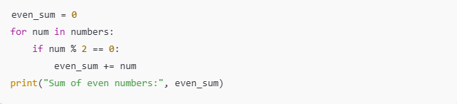
Retrieving Values
Access by index
Looping through array

Slide 6
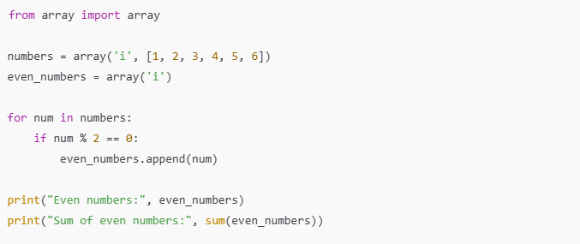
Problem: Create an array of even numbers from a given array and display the sum.

Slide 7
Lists

Slide 8
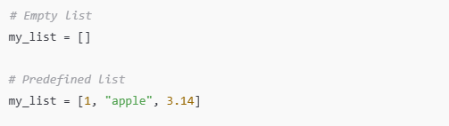

Definition: Lists are dynamic, ordered, mutable collections in Python that can hold multiple data types.
Declaration:
Adding Values:
Append

Slide 9


Adding Values:
2. Extend (adding multiple items)
3. Insert (adding item in a specific index)

Slide 10


Retrieving Values
Access by index
Looping through list

Slide 11
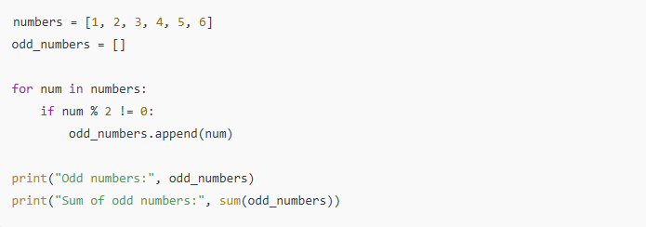
Problem: Create a list of odd numbers from a given list and display the sum.

Slide 12
List Operations

Slide 13
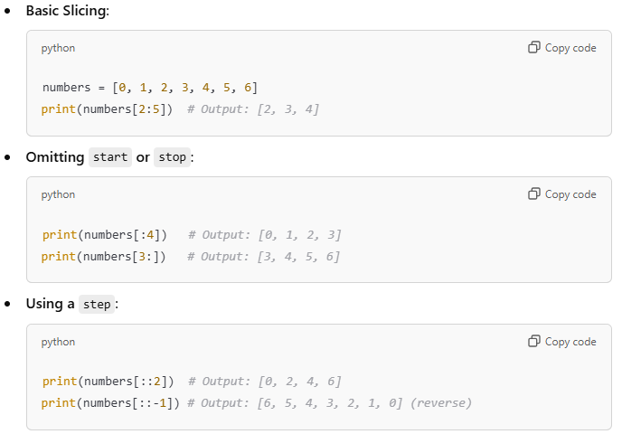
List Slicing
Definition: Slicing allows accessing a subset of elements from a list using the format: list[start:stop:step]

Slide 14
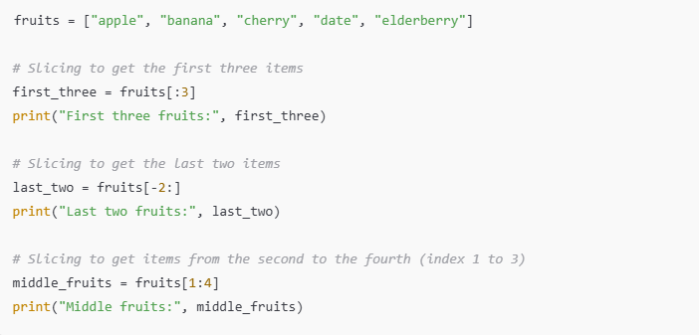
An example of list slicing

Slide 15
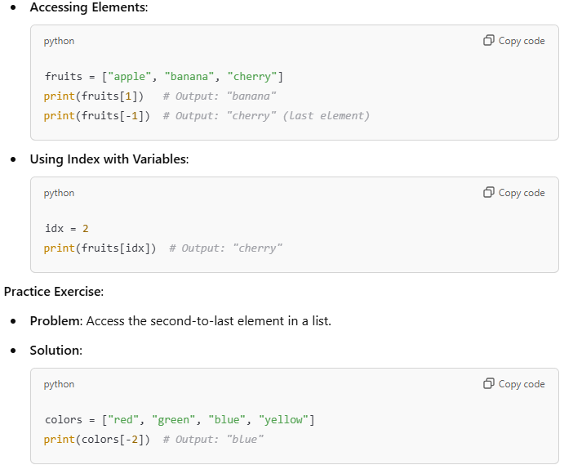
List Indexing

Slide 16
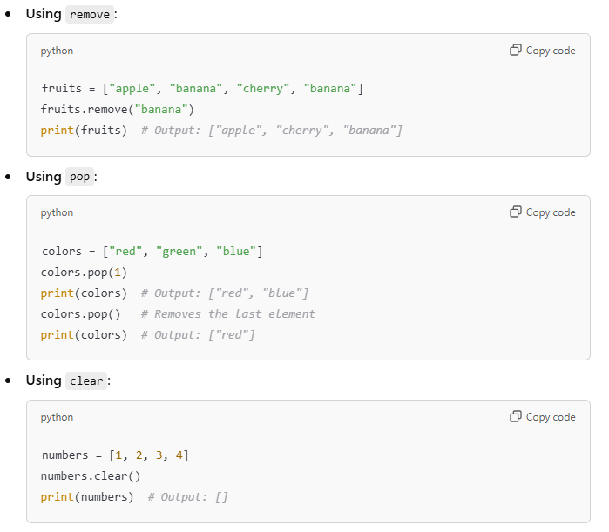
Removing elements from a list

Slide 17
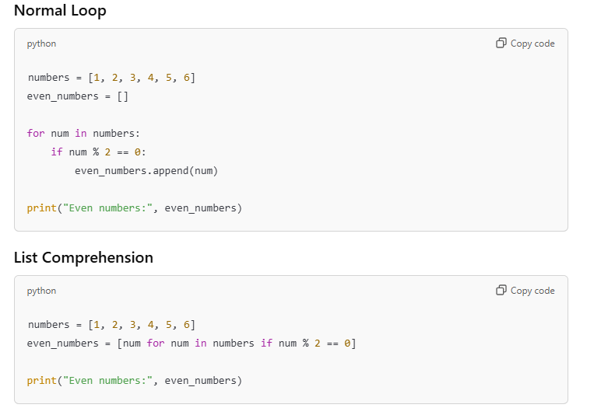
List Comprehension
Bottom line: One line of code to make your life easy!!!

Slide 18
Sets

Slide 19
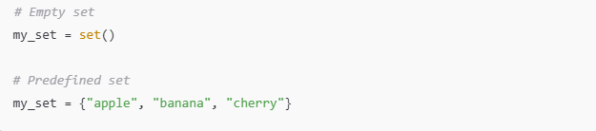
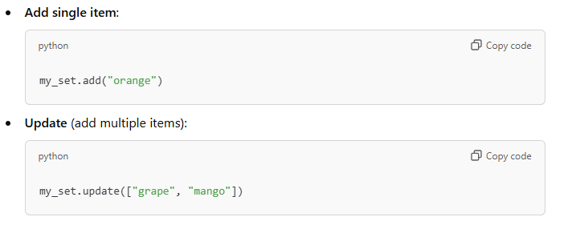
Definition: Sets are unordered collections of unique items, used for fast membership testing.
Declaration:
Adding Values:

Slide 20
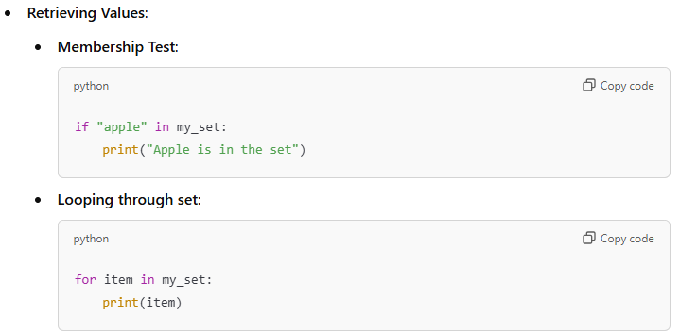

Slide 21
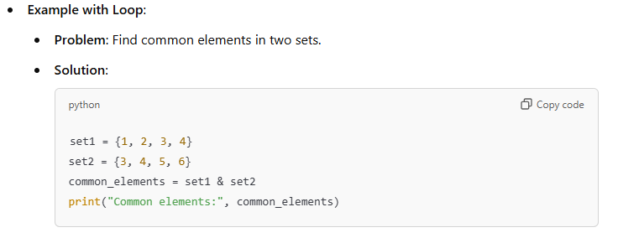
No duplicates
Set operations: Union, Intersection, Difference

Slide 22
Tuples

Slide 23
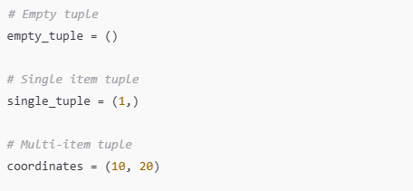
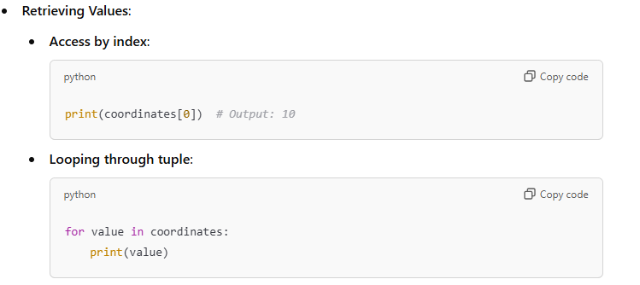
Definition: Tuples are immutable, ordered collections that cannot be changed after creation.
Declaration:
Adding Values: Cannot add or update values

Slide 24
Dictionaries

Slide 25
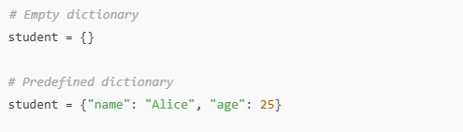
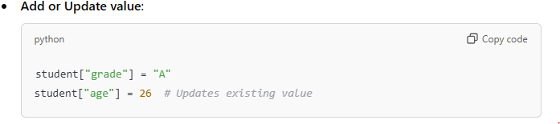
Definition: Dictionaries are collections of key-value pairs with unique keys.
Declaration:
Adding Values:

Slide 26
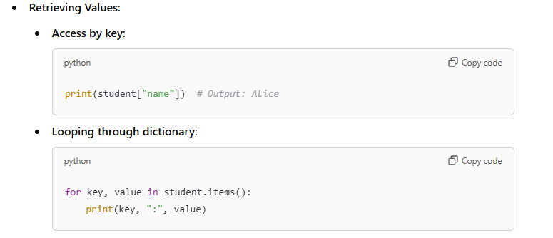
Output:
name: Alice
age: 25

Slide 27
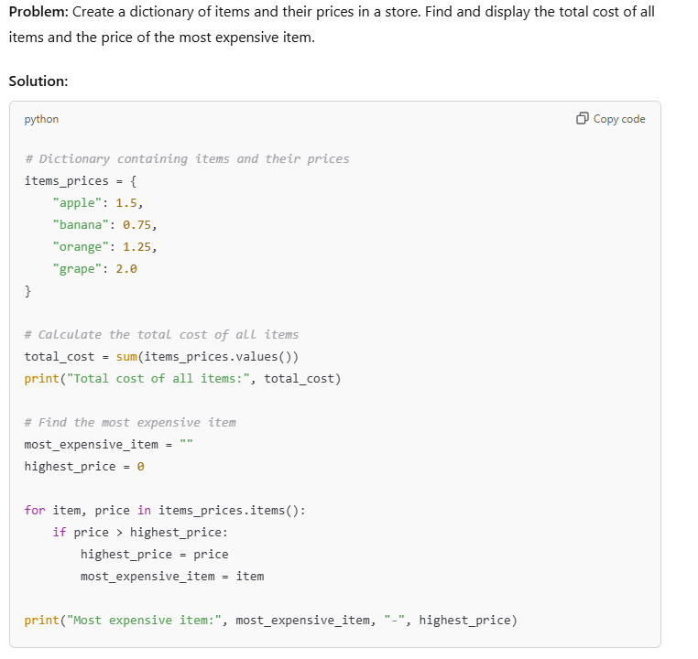

Slide 28
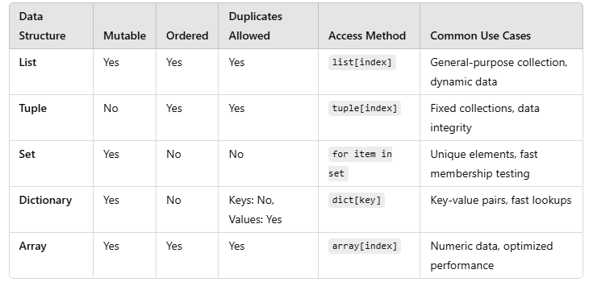

Slide 29
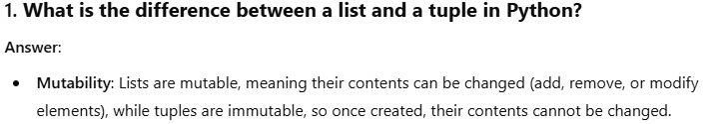
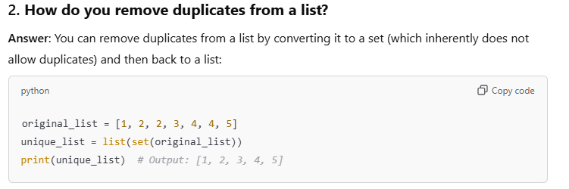
Some Interview Questions

Slide 30
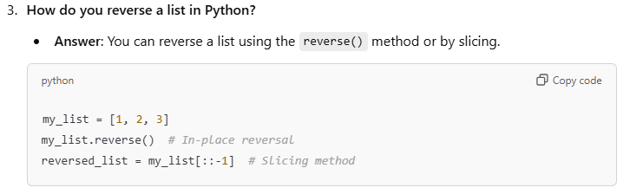
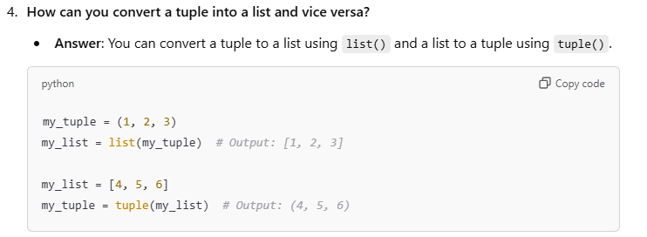
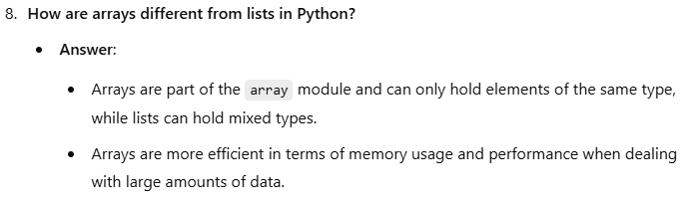

Slide 31
Thank You

